Slide 1



Probability measure on random variables
Scarlette Berenice Alcaraz Muñiz

Slide 2
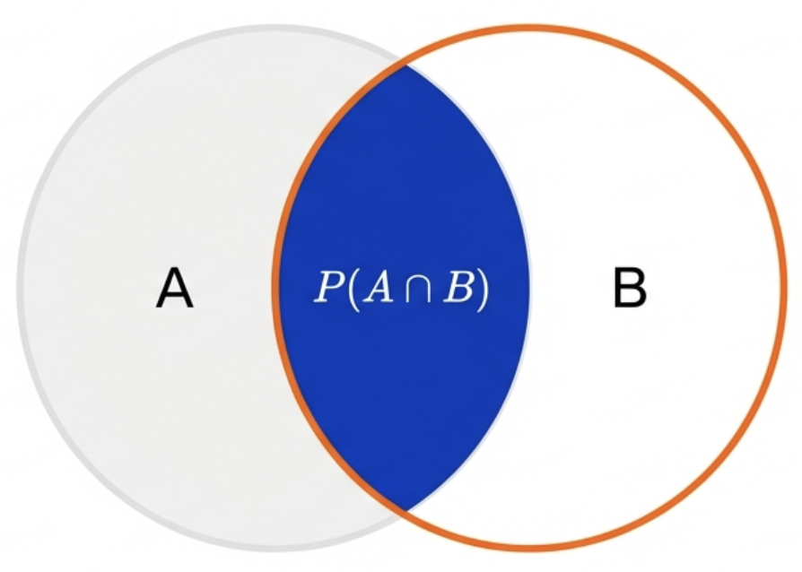
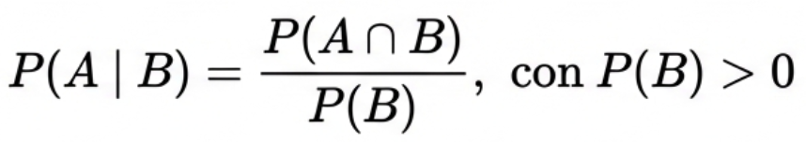
Conditional Probability
Conditional probability measures the occurrence of an event A, given that an event B has already occurred.
Event B becomes the new sample space.
We no longer care about outcomes outside of B; the universe has "shrunk."
Probability depends on the intersection relative to the size of B.

Slide 3
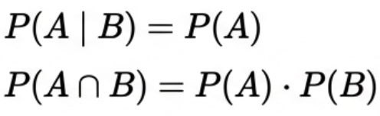
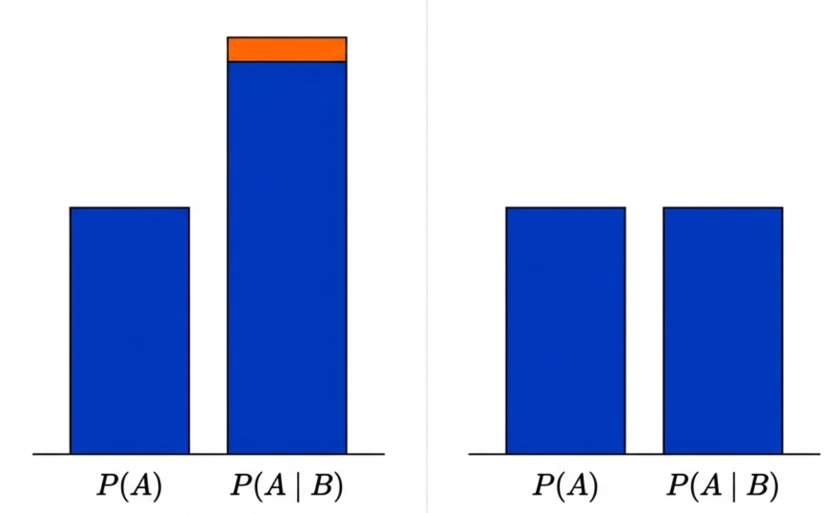
Conditional Probability
Two events are independent if knowing B provides no information about A.
Dependence vs Independence
Dependence:
The information changes the probability.
Independence:
The information doesn’t have an efect

Slide 4
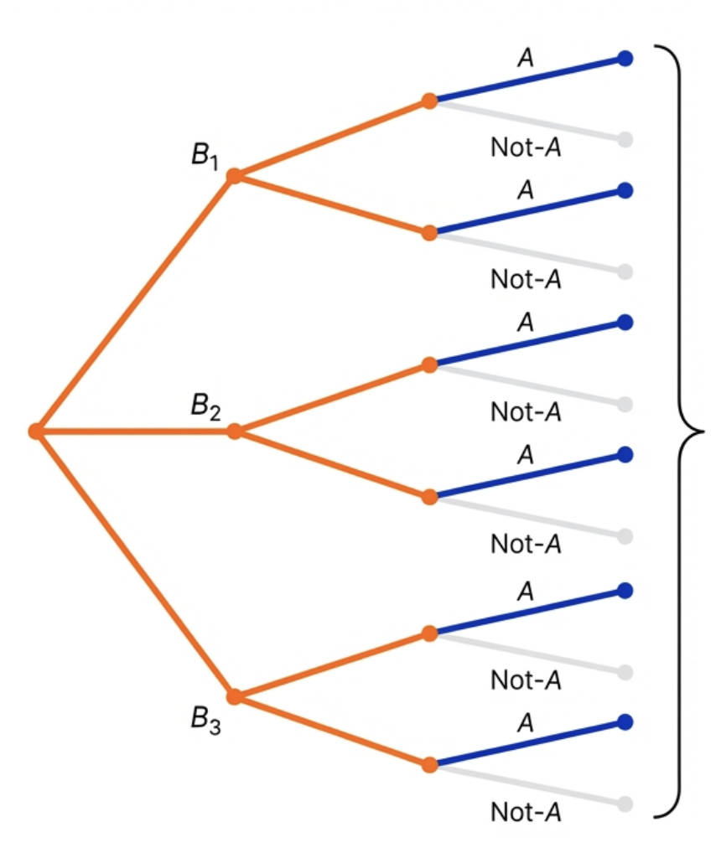
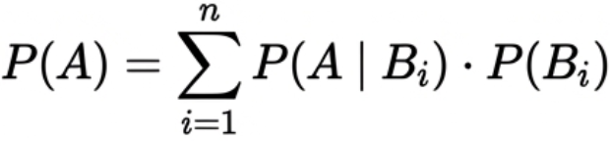
Law of Total Probability
Concept: "Divide and Conquer" Strategy
To calculate a complex event (A), we sum its constituent parts (Bi).
Context: A weighted average of mutually exclusive scenarios.
P(A) = Sum of all blue paths.

Slide 5
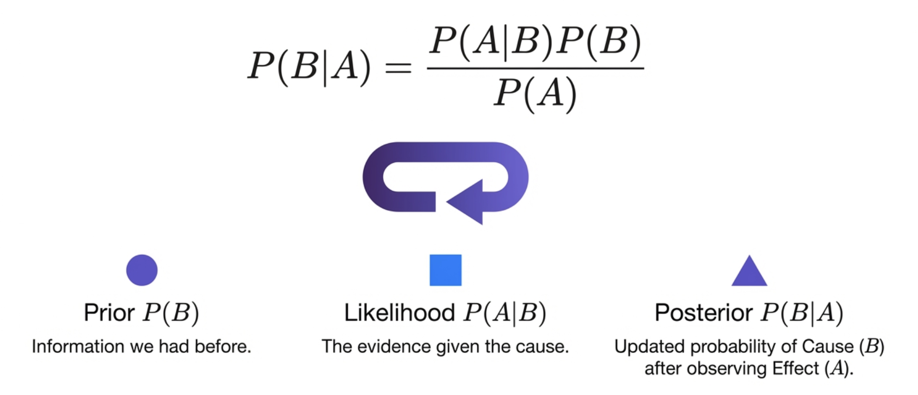
Bayes' Theorem
The mechanism for updating beliefs when faced with new evidence.

Slide 6
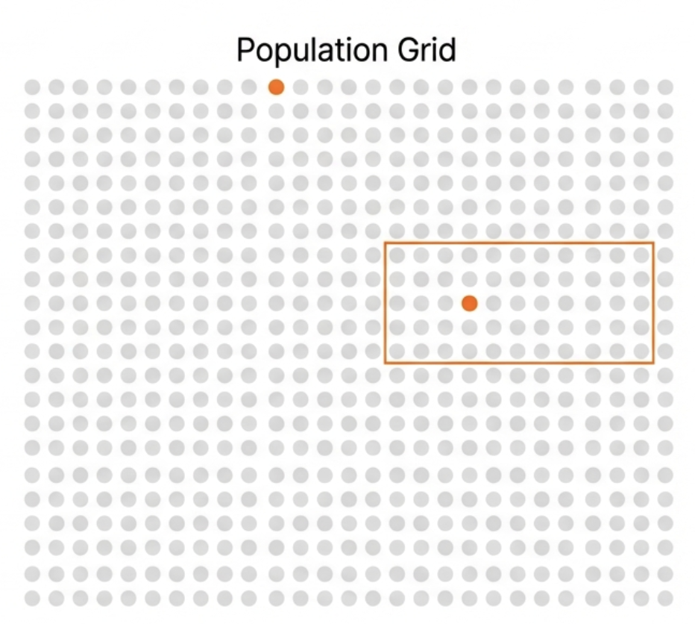
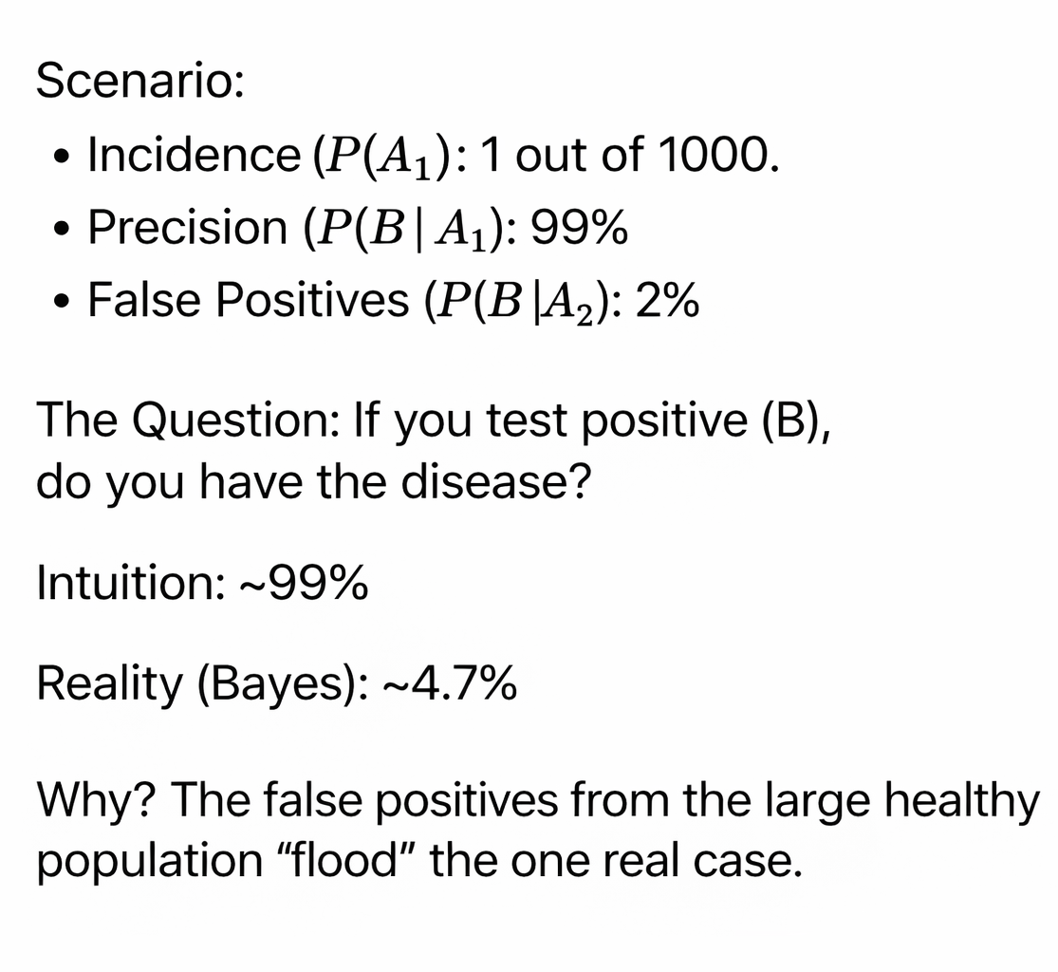
Bayes' Theorem
Intuition vs. Mathematics

Slide 7
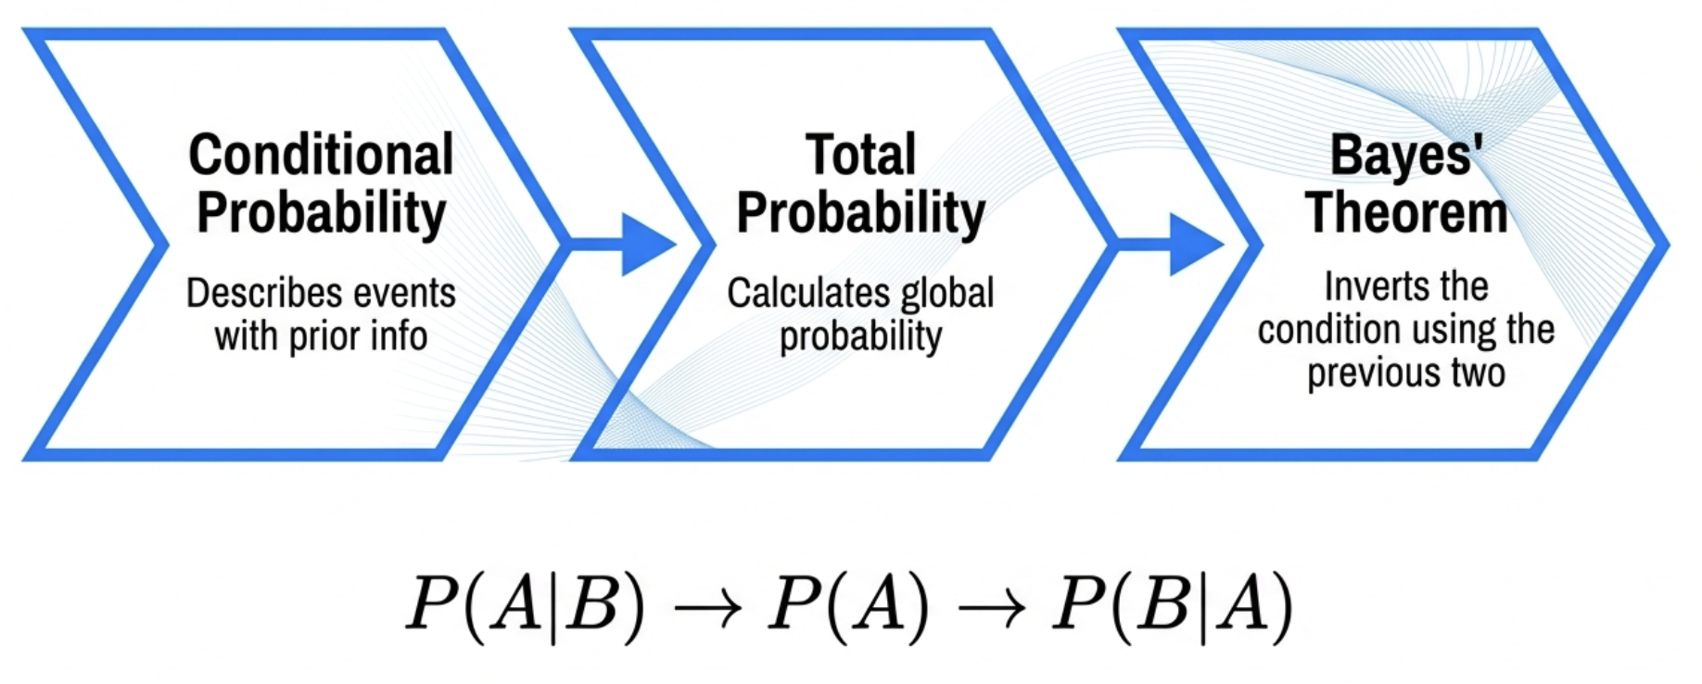
Relationship Between Concepts

Slide 8
References
Devore, J. L. (2008). Probability and Statistics for Engineering and Science (7th ed.). Cengage Learning.

